Slide 1

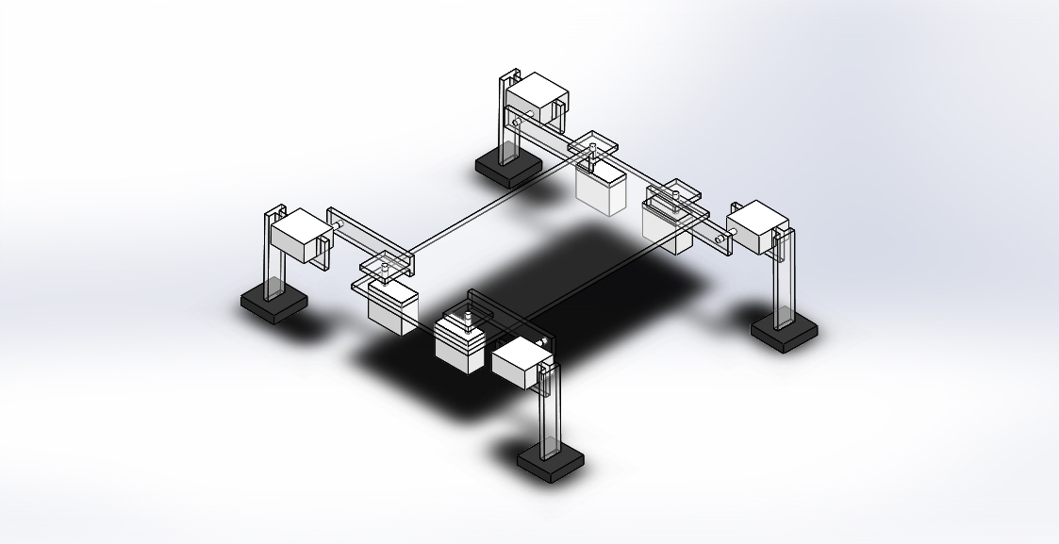
Locomotion of Quadruped legged robot
PRESENTED BY:
Ashish Agrawala
Krishna Agrawal
Shubham p. gothale

Slide 2
Contents
1, Introduction to gaits and gait diagram
2. Types of gaits
Creep Gait
Locomotion order (1423)
Locomotion order (1234)
Locomotion order (1243)
Dynamic gaits
Trot gait
Pace gait
Bound gait

Slide 3
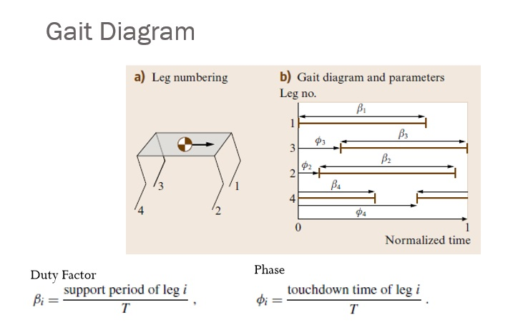
Introduction to gaits and gait diagram
Gait are defines as the pattern of movement of limb during locomotion over solid substrate.
Source: atulthakur/iitp/webpage

Slide 4
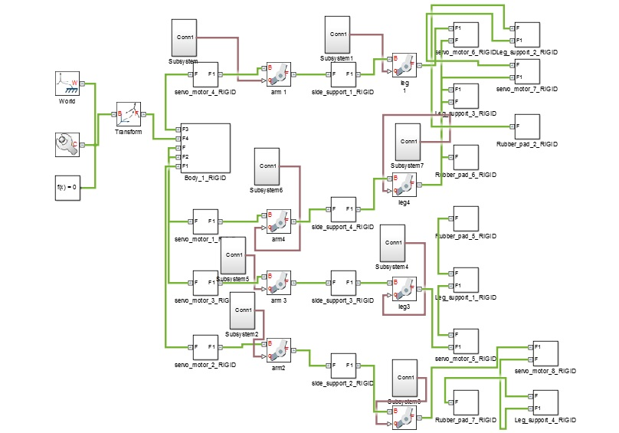
TYPES OF GAITS
1. Crawl Gait(1423):
Fig: Simulink design for crawl gait

Slide 5
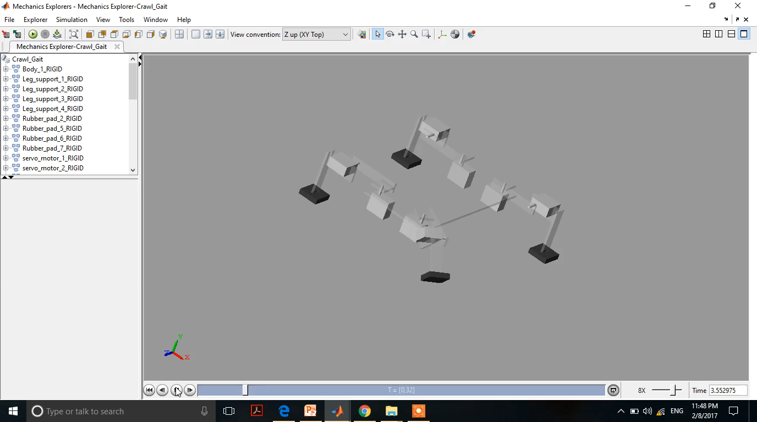
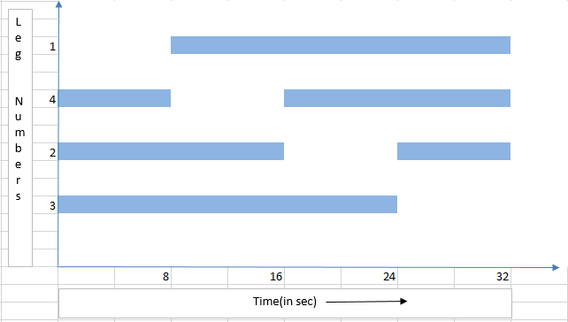
1. Crawl Gait(1423) [Contd.]:
Fig: Gait Diagram

Slide 6
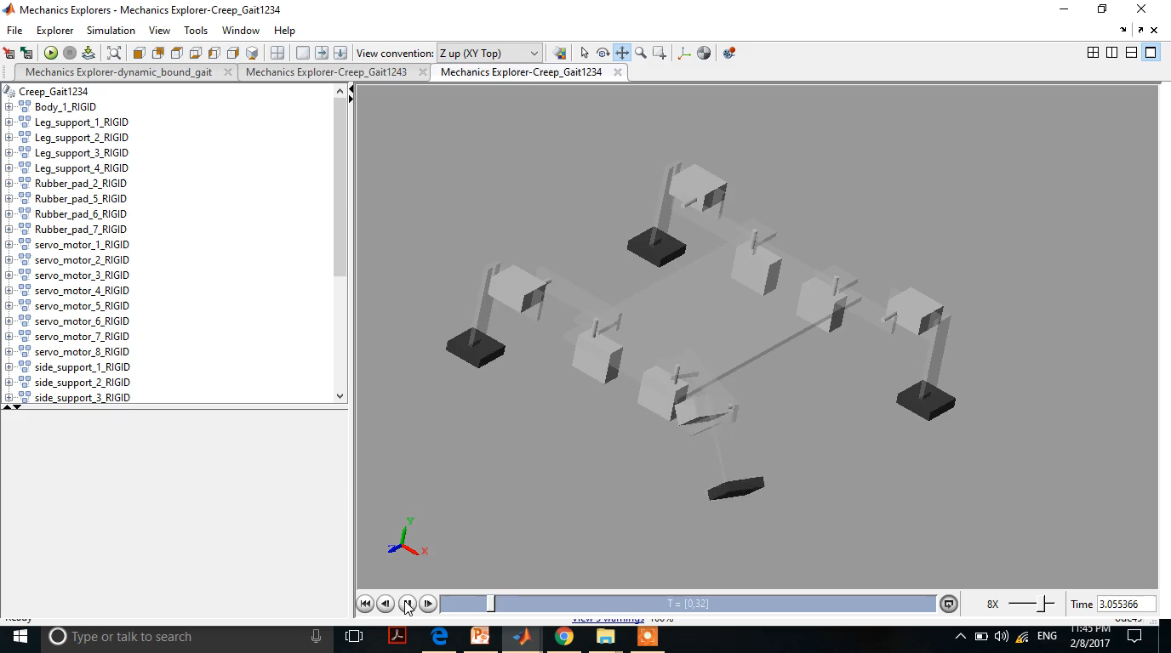

2. Creep Gait (1234):
Fig: Gait Diagram

Slide 7
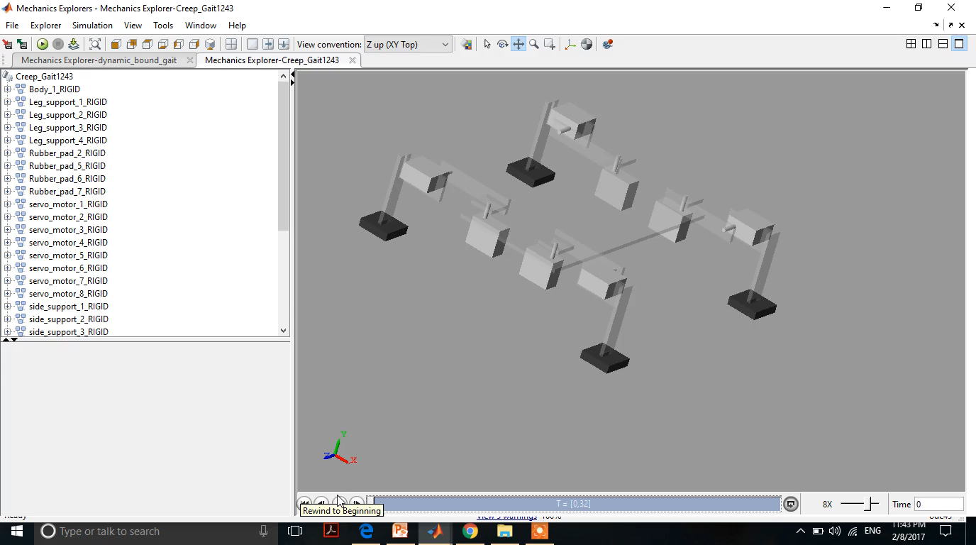
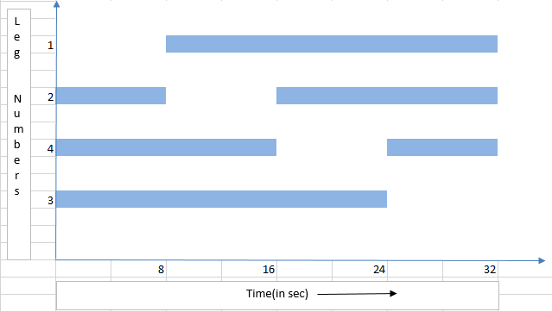
3. Creep Gait (1243):
Fig: Gait Diagram

Slide 8
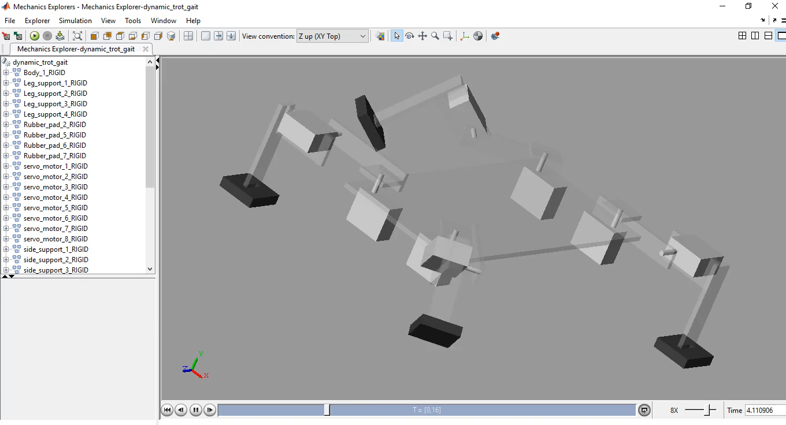
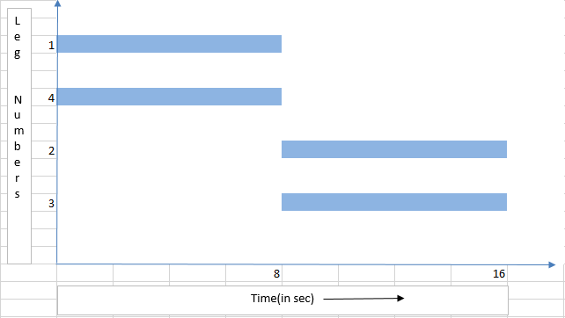
DYNAMIC GAITS
1. Trot Gait(1423):
Fig: Gait Diagram

Slide 9
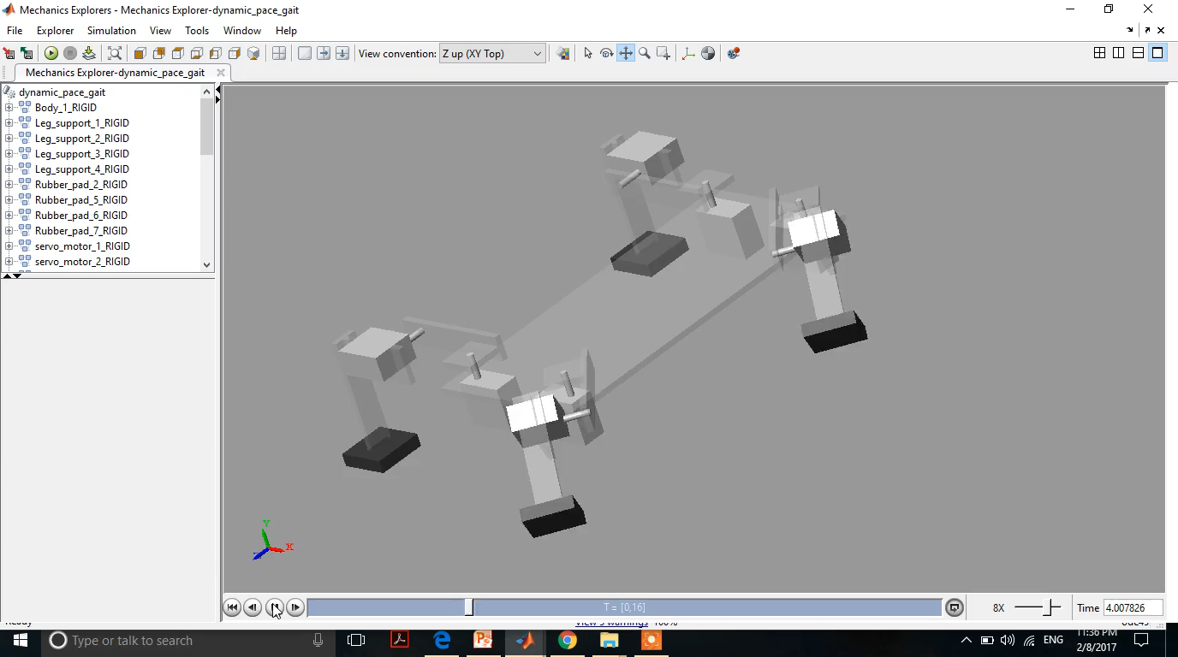
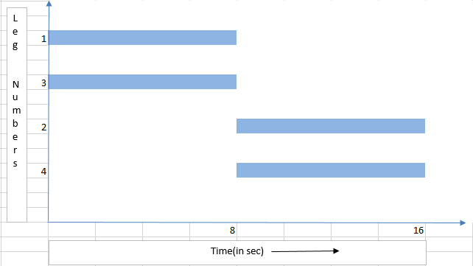
2. Pace Gait(1324):
Fig: Gait Diagram

Slide 10
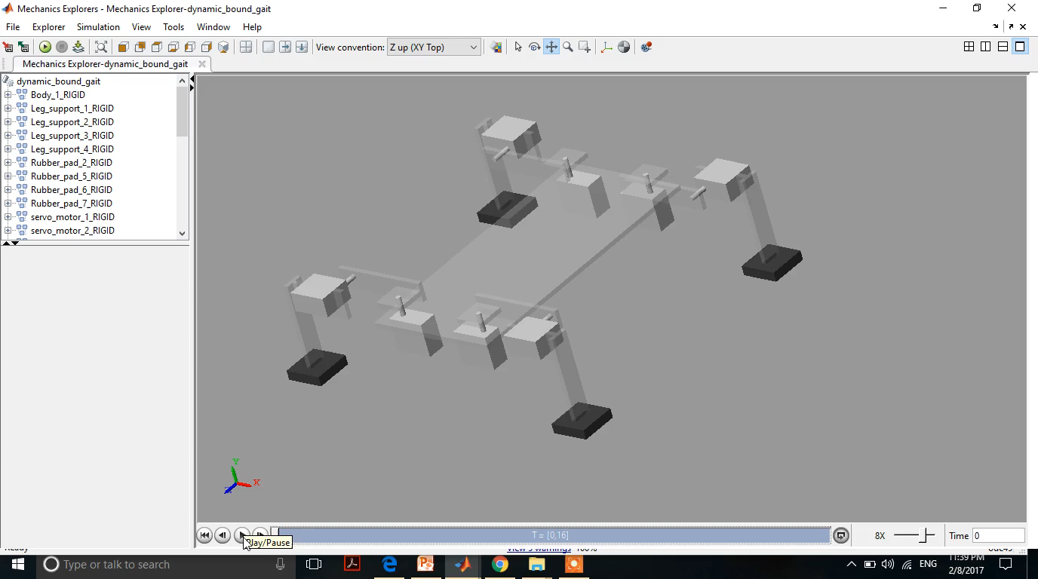
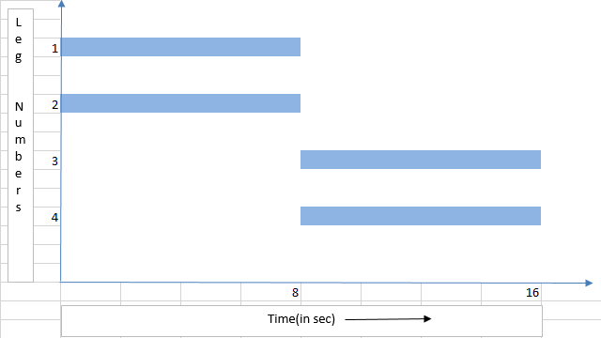
3. Bound Gait(1234):
Fig: Gait Diagram

Slide 11
REFERENCES
Chen X., Gao F., Qi C., Tian X, Wei L., Kinematic analysis and motion planning of a quadruped robot with partially faulty actuators, Mechanism and Machine Theory 94 (2015) 64–79

Slide 12


